Slide 1
Welcome to the third virtual meeting of the Culture/Cultural Heritage Partnership!
The meeting will start at 10.00. Please feel free to test your microphone and camera in the meanwhile.
Please note that this meeting will be recorded, and the chat and the voting results saved
If you have any technical difficulties, you can contact us via phone:
+32 2 743 89 31
or email:
UA.communication@Ecorys.com

Slide 2
Please go to www.menti.com and use the code 77 28 77

Slide 3
Culture/Cultural Heritage Partnership
3rd Partnership meeting – day 2
Webex meeting, 25 June 2020

Slide 4
Please remember to mute your microphone and turn off your camera when the meeting starts and when you are not speaking.
If you have any technical difficulties, you can contact us via phone:
+32 2 743 89 31
or email:
UA.communication@Ecorys.com

Slide 5
Opening

Slide 6
Agenda 25 June, 10:00-12:00
Chapter 1: Recap day 1 (18 June)
Recap day 1
Open Feedback and Q&A
Chapter 2: Next steps
Timeline and consultations
How to work together?
Q&A
Chapter 3: Setting the Action Groups
Setting the Action Groups
Q&A
Conclusions and next steps

Slide 7
Obj. of Plenary meeting 2 (25/06)
According to the results of the ranking of actions achieved at the 18 June and after a consultation activity among Partners:
CONSOLIDATION OF ACTION GROUPS;
methods and tools of the Action design process.
At the end of today’s meeting, the Action groups will be set and ready to start writing the actions for the Action Plan to be finalised before 3rd of September !!!

Slide 8
Chapter 1:
Recap Day 1 (18 June)
Sandra Gizdulich, Giovanni Pineschi | Agenzia per la Coesione Territoriale
Jan Schultheiß | Federal Ministry of the Interior,
Building and Community

Slide 9
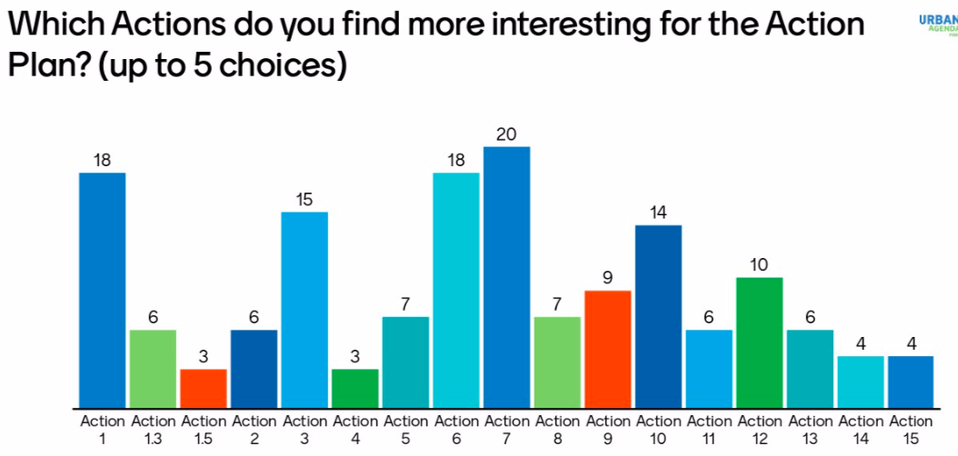
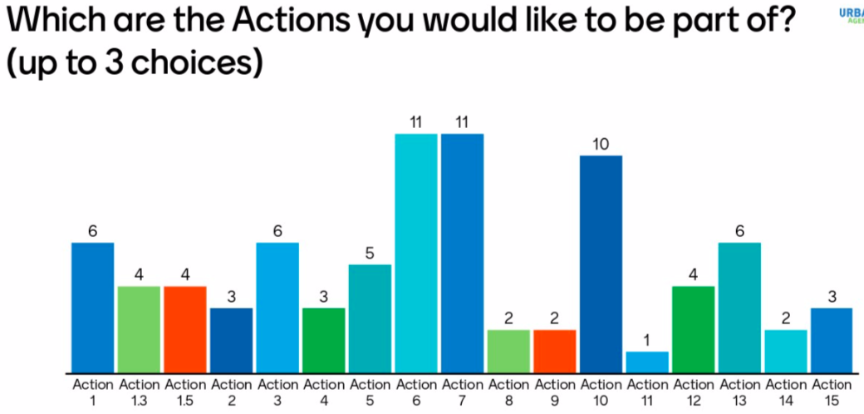

Slide 11
Questions & Answers
If you have any questions/comment, please write your name and organisation in the chat box (send to: all participants).
We will then give you the floor to share your views (depending on the time available).

Slide 12
Chapter 2:
Next steps
Sandra Gizdulich, Giovanni Pineschi | Agenzia per la Coesione Territoriale
Jan Schultheiß | Federal Ministry of the Interior,
Building and Community

Slide 13
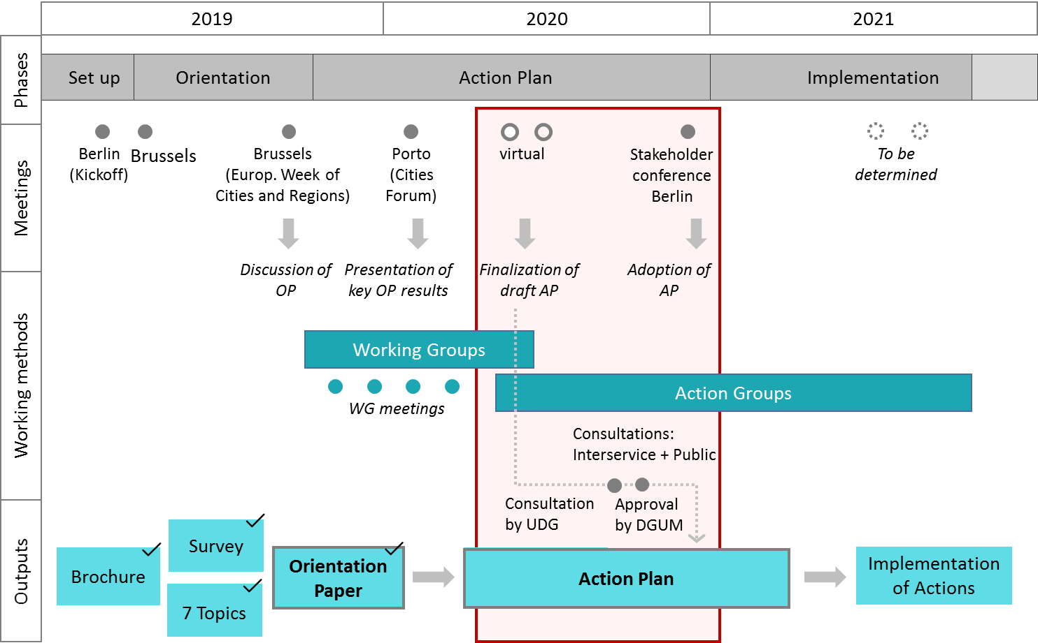
Timeline towards Action Plan

Slide 14
Timeline: Steps to the Action Plan
Next steps:
Confirm your interest today or at the latest by Monday morning (29 June)
Get in touch with Action Leaders by 1 July
Help prepare the Public consultation (by mid-July)
Further define Actions (see following slides) by end of July
Incorporate feedback from Public and Interservice Consultations
Have the Action ready for Action Plan submission on September 3!

Slide 15
Towards the
Action implementation
Laura Hagemann | European Commission
(DG REGIO)

Slide 16
Fine-tuning the Actions
Always take into account the feasibility of Actions and their results (result-oriented approach)
Merging Actions could impact the internal feasibility of Actions
Important to structure what needs to be done and by whom (ownership on the implementation)
Crucial role of Action Leaders but need to engage with Partners
Have clear set of activities and deliverables
Consider interlinkages across Actions – don’t work in silos

Slide 17
The consultation process
Have informal and internal consultation on the Actions – to get feedback but also to promote ownership
Encourage feedback from your network – let them join the Public Feedback - open on Futurium for at least 6 weeks
Get guidance and feedback is also a way to ensure synergy and promote cooperation
Draft AP submitted for ISC
Collection of feedback
Draft AP is sent to UDG
AP presented at DG UM
Draft AP submitted for Public feedback
Implementation of comments

Slide 18
Towards the implementation phase
Set realistic milestones and try to stick to those
Make use of a good methodology and effective tools (e.g. by using templates provided by the Secretariat)
Find an efficient but collaborative working method
Make use of expertise (when needed)

Slide 19
How to work together?
Sandra Gizdulich, Giovanni Pineschi | Agenzia per la Coesione Territoriale
Jan Schultheiß | Federal Ministry of the Interior,
Building and Community

Slide 20
From Thematic Working Group to Action Working group
ACTION WG
5 THEMATIC WGs

Slide 21
What is an Action?
Syntax and guiding questions
The syntax of an Action lies on the following questions:
What is the specific problem?
Which action is needed?
How to implement the action?
Which partners?
Which timeline?

Slide 22
What is an Action?
Some examples (1)
1) Partnership on the Inclusion of Migrants and Refugees: Establishment of an Academy on Integration strategies
How to implement the action ?
Develop a questionnaire to assess needs and interest from the city perspective and identify possible topics for the pilot project
Definition of the scope, methodology, funding possibilities for a pilot project that will involve the organisation of two/three thematic modules (of each 2-days)
Implementation of the pilot action
Evaluation of the pilot
If the pilot is successful: Drafting of plan for ensuring sustainability of the Academy, for example by embedding it in existing structures or initiatives at European level.
Partnership members:
Action leader: DG HOME;
Members: City of Amsterdam, Portugal, CEMR, URBACT and EUROCITIES and DG REGIO.
Which timeline?
Preparation: June 2017 – February 2018.
Implementation: March – April 2018.
Finalisation: December 2018.

Slide 23
What is an Action?
Some examples (2)
2) Partnership on Circular Economy Prepare a Circular City Funding Guide to assist cities in accessing funding for circular economy projects
How to implement the action ?
1) preparation of a guide to funding and financing sources for circular initiatives and projects in cities
How to implement the action?
The guide will be implemented in the form of a website, with preparation carried out in two phases.
1a) The first phase will comprise desk research, interviews with stakeholders, preparation of an interactive PDF prototype of the guide that will serve as a basis for discussions with stakeholders.
1b) The second phase will comprise development and implementation of the website, including migration to a suitable web host.
Which partners?
Action leader: European Investment Bank (EIB)
Participants: Flanders region, Slovenia, ACR+, DG RTD, DG REGIO, DG ENV
Which timeline?
Start at the end of January 2018.
The work will be planned with a goal to have a first version of the guide ready by mid-2019.

Slide 24
What is an Action?
Some examples (3)
3) Partnership on Public Procurement: Legal Handbook Innovative Public Procurement
Activities | Who | Estimated deadline
Analysing the European Procurement Law: | Munich Vantaa, Gabrovo, Italy, DG GROW, LUISS LabGov, CEMR, Nantes, KEINO | December 2018
Researching existing guidelines, | Munich Vantaa, Gabrovo, Italy, DG GROW, LUISS LabGov, CEMR, Nantes, KEINO | December 2018
Interviews, discussions: | Munich Vantaa, Gabrovo, Italy, DG GROW, LUISS LabGov, CEMR, Nantes, KEINO | March 2019
Legal handbook production | Munich Vantaa, Gabrovo, Italy, DG GROW, LUISS LabGov, CEMR, Nantes, KEINO | September 2019
Promoting (the legal handbook): | Munich Vantaa, Gabrovo, Italy, DG GROW, LUISS LabGov, CEMR, Nantes, KEINO | December 2019
Analysing the European Procurement Law: | Munich Vantaa, Gabrovo, Italy, DG GROW, LUISS LabGov, CEMR, Nantes, KEINO | December 2018

Slide 25
Choosing to participate in an Action
Partners who choose an action will participate in the design of the action: definition of outputs, milestones, etc.;
Partners involved in the planning of the action need to reflect on what they wish to work on, according to their interests and resources;
Once the working group has been defined:
Partners agree together on activities, outputs, milestones, deliverables and on “who does what and when” (!!)

Slide 26
How to start to work together?
An action can be considered as a brief temporal sequence of activities
that produce outputs (deliverables).
An Action Leader is the conductor (in the timing set by the Partnership):
Builds the first draft of the action (for the Action Plan);
Summons the kick-off meeting to define the action (also VC);
All the important activities (being responsible for the action …)
Partners contribute to the action design, suggesting activities and deliverables and deciding if and what to do within the actions (Activities). Partners can be external as well;
Action are composed by one or more activities carried out by the Action Leader together with one or more partners to achieve a specific deliverable.

Slide 27
Model of an Action
As exemplification, below are described the components of an activity
Activity | Description | Responsible | Participants | duration | From | to | OUTPUT (Deliverable ) | Result
Number of the activity | Description of the activity, what is the aim, what is the purpose of the activity in the framework of the Action | Who leads the activity (Action Leader, Partner) | All partners that participate in the activity. They would specify who does what (tasks) | Overall duration of the activity | Starting date of the activity | Closing date of the activity | Deliverable considered as output of the Activity | What you achieve

Slide 28
Questions & Answers
If you have any questions/comment, please write your name and organisation in the chat box (send to: all participants).
We will then give you the floor to share your views (depending on the time available).

Slide 29
Chapter 3:
Setting the
Action Groups

Slide 30
Setting the Action Groups
To express your willingness in taking part in an Action group(s), please write your name and organisation in the chat box (send to: all participants) when your Action(s) of interest is mentioned

Slide 31
Questions & Answers
If you have any questions/comment, please write your name and organisation in the chat box (send to: all participants).
We will then give you the floor to share your views (depending on the time available).

Slide 32
Conclusions and next steps

Slide 33
Please use your communication channels to give visibility to the Public Consultation!
Please mark your calendars!
  EWRC Brussels (or virtual) 12-15 October
  Stakeholder Conference Berlin (or virtual)
  24/25 November

Slide 34

Thank you!

